Slide 1
Evolutionary Computation
Khaled Rasheed
School of Computing
University of Georgia
http://www.cs.uga.edu/~khaled

Slide 2
Presentation outline
Genetic algorithms
  Parallel genetic algorithms
Genetic programming
Evolution strategies
Classifier systems
Evolution programming
Related topics
Conclusion

Slide 3
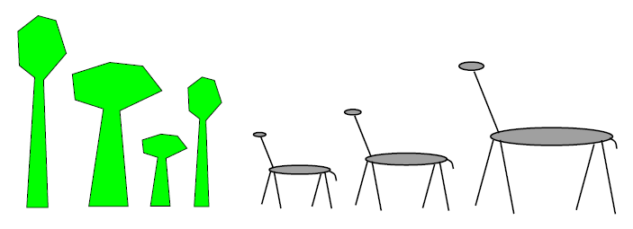
In the forest
Initially equal proportions of Giraffe and tree species

Slide 4
One million years later
Average Giraffe height will probably
  Increase
  same
  Decrease

Slide 5
One million years later
Average tree height will probably
  Increase
  same
  Decrease

Slide 6
One million years later
Maximum Giraffe height will probably
  Increase
  same
  Decrease

Slide 7
One million years later
Maximum tree height will probably
  Increase
  same
  Decrease

Slide 8
In the forest
Fitness = Height
Survival of the fittest

Slide 9
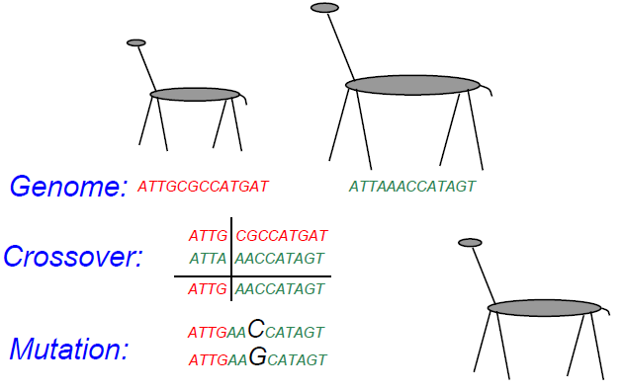
Reproduction

Slide 10
Genetic Algorithms
Maintain a population of potential solutions
New solutions are generated by selecting, combining and modifying existing solutions
  Crossover
  Mutation
Objective function = Fitness function
  Better solutions favored for parenthood
  Worse solutions favored for replacement

Slide 11
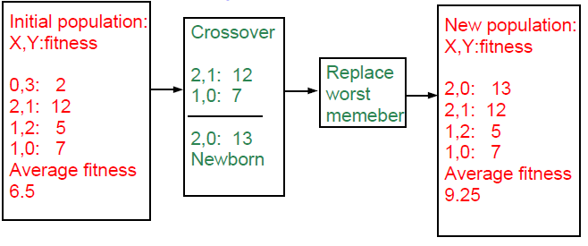
Example: numerical optimization
Maximize 2X^2-y+5 where X:[0,3],Y:[0,3]

Slide 12
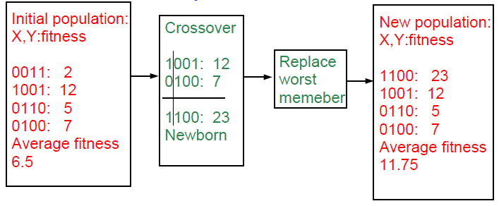
Example with binary representation
Maximize 2X^2-y+5 where X:[0,3],Y:[0,3]

Slide 13
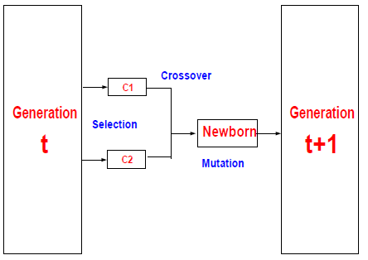
Elements of a generational genetic algorithm
Representation
Fitness function
Initialization strategy
Selection strategy
Crossover operators
Mutation operators

Slide 14
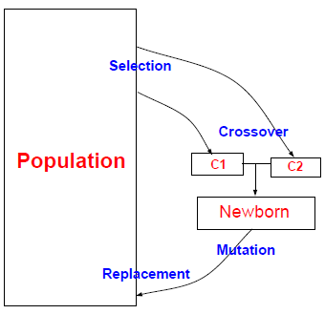
Elements of a steady state genetic algorithm
Representation
Fitness function
Initialization strategy
Selection strategy
Crossover operators
Mutation operators
Replacement strategy

Slide 15
Selection strategies
Proportional selection (roulette wheel)
  Selection probability of individual = individual’s fitness/sum of fitness
Rank based selection
  Example: decreasing arithmetic/geometric series
  Better when fitness range is very large or small
Tournament selection
  Virtual tournament between randomly selected individuals using fitness

Slide 16
Crossover Operators
Point crossover (classical)
  Parent1=x1,x2,x3,x4,x5,x6
  Parent2=y1,y2,y3,y4,y5,y6
  Child =x1,x2,x3,x4,y5,y6
Uniform crossover
  Parent1=x1,x2,x3,x4,x5,x6
  Parent2=y1,y2,y3,y4,y5,y6
  Child =x1,x2,y3,x4,y5,y6
Arithmetic crossover
  Parent1=x1,x2,x3
  Parent2=y1,y2,y3
  Child =(x1+y1)/2,(x2+y2)/2,(x3+y3)/2

Slide 17
Mutation Operators
change one or more components
Let Child=x1,x2,P,x3,x4...
Gaussian mutation:
  P ¬ P ± ∆p
  ∆ p: (small) random normal value
Uniform mutation:
  P ¬ P new
  p new : random uniform value
boundary mutation:
  P ¬ Pmin OR Pmax
Binary mutation=bit flip

Slide 18
Advantages of Genetic-Algorithm based optimization
Finds global optima
Can handle discrete, continuous and mixed variable spaces
Easy to use (short programs)
Robust (less sensitive to noise, ill conditions)

Slide 19
Disadvantages of Genetic-
Algorithm based optimization
Relatively slower than other methods (not suitable for easy problems)
Theory lags behind applications

Slide 20
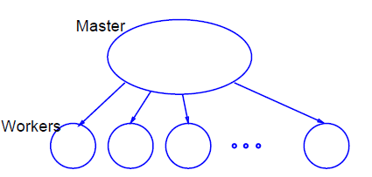
Global parallel GA

Slide 21
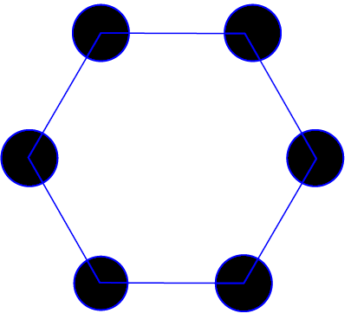
Coarse-grained parallel GA (Island model)

Slide 22
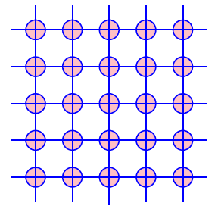
Fine-grained parallel GA

Slide 23
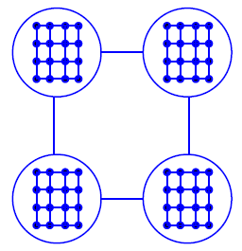
Hybrid parallel GA
Coarse-grained GA at high level
Fine-grained GA at low level

Slide 24
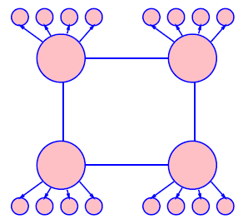
Hybrid parallel GA
Coarse-grained GA at high level
Global parallel GA at low level

Slide 25
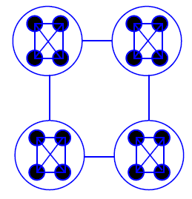
Hybrid parallel GA
Coarse-grained GA at high level
Coarse-grained GA at low level

Slide 26
Genetic Programming (GP)
Introduced (officially) by John Koza in his book (genetic programming, 1992)
Early attempts date back to the 50s (evolving populations of binary object codes)
Idea is to evolve computer programs
Declarative programming languages usually used (Lisp)
Programs are represented as trees

Slide 27
GP individuals
A population of trees representing programs
The programs are composed of elements from the FUNCTION SET and the TERMINAL SET
These sets are usually fixed sets of symbols
The function set forms "non-leaf" nodes. (e.g. +,-,*,sin,cos)
The terminal set forms leaf nodes. (e.g. x,3.7, random())

Slide 28
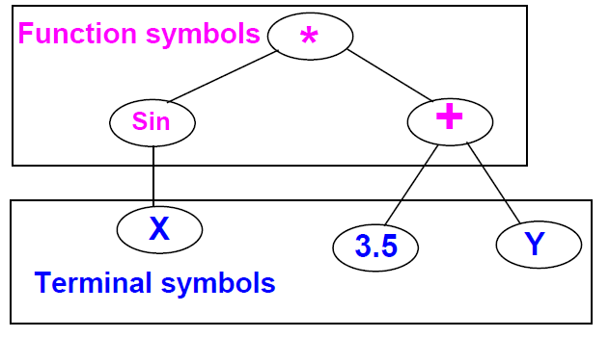
Example: GP individual

Slide 29
GP operation
Fitness is usually based on I/O traces
Crossover is implemented by randomly swapping subtrees between individuals
GP usually does not extensively rely on mutation (random nodes or subtrees)
GPs are usually generational (sometimes with a generation gap)
GP usually uses huge populations (1M individuals)

Slide 30
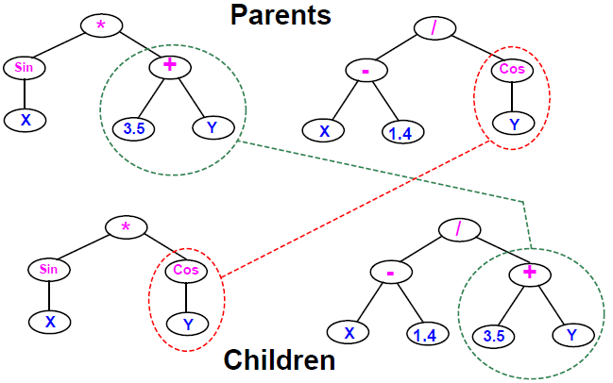
Example: GP crossover

Slide 31
Advantages of GP over GAs
More flexible representation
Greater application spectrum
If tractable, evolving a way to make “things” is more useful than evolving the “things”.
Example: evolving a learning rule for neural networks vs. evolving the weights of a particular NN.

Slide 32
Disadvantages of Genetic Programming
Extremely slow
Very poor handling of numbers
Very large populations needed

Slide 33
GP variants
Genetic programming with linear genomes (Wolfgang Banzaf)
  Kind of going back to the evolution of binary program codes
Hybrids of GP and other methods that better handle numbers:
  Least squares methods
  Gradient based optimizers
  Genetic algorithms, other evolutionary computation methods
Evolving things other than programs
  Example: electric circuits represented as trees (Koza, AI in design 1996)

Slide 34
Evolution Strategies (ES)
Were invented to solve numerical optimization problems
Originated in Europe in the 1960s
Initially: two-member or (1+1) ES:
  one PARENT generates one OFFSPRING per GENERATION
  by applying normally distributed (Gaussian) mutations
  until offspring is better and replaces parent
  This simple structure allowed theoretical results to be obtained (speed of convergence, mutation size)
Later: enhanced to a (μ+1) strategy which incorporated crossover

Slide 35
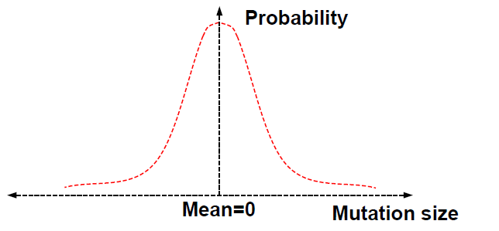
Normal (Gaussian) mutation

Slide 36
Modern evolution strategies
Schwefel introduced the multi-membered ESs now denoted by (μ +λ) and (μ, λ)
(μ, λ) ES: The parent generation is disjoint from the child generation
(μ + λ) ES: Some of the parents may be selected to "propagate" to the child generation

Slide 37
ES individuals
Real valued vectors consisting of two parts:
  Object variable: just like real-valued GA individual
  Strategy variable: a set of standard deviations for the Gaussian mutation
This structure allows for "Self-adaptation“ of the mutation size
  Excellent feature for dynamically changing fitness landscape

Slide 38
Machine learning and evolutionary computation
In machine learning we seek a good hypothesis
The hypothesis may be a rule, a neural network, a program ... etc.
GAs and other EC methods can evolve rules, NNs, programs ...etc.
Classifier systems (CFS) are the most explicit GA based machine learning tool.

Slide 39
Elements of a classifier system
Rule and message system
  if <condition> then <action>
Apportionment of credit system
  Based on a set of training examples
  Credit (fitness) given to rules that match the example
  Example: Bucket brigade (auctions for examples, winner takes all, existence taxes)
Genetic algorithm
  evolves a population of rules or a population of entire rule systems

Slide 40
The Michigan approach: population of rules
Evolves a population of rules, the final population is used as the rule and message system
Diversity maintenance among rules is hard
If done well converges faster
Need to specify how to use the rules to classify
  what if multiple rules match example?
  exact matching only or inexact matching allowed?

Slide 41
The Pittsburgh approach
Each individual is a complete set of rules or complete solution
Avoids the hard credit assignment problem
Slow because of complexity of space

Slide 42
Evolution programming (EP)
Classical EP evolves finite state machines (or similar structures)
Relies on mutation (no crossover)
Fitness based on training sequence(s)
Good for sequence problems (DNA) and prediction in time series

Slide 43
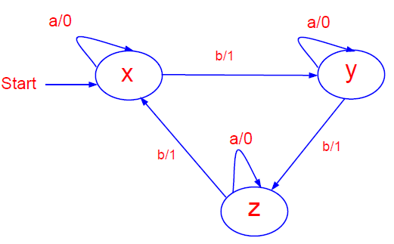
EP individual

Slide 44
EP mutation operators
Add a state (with random transitions)
Delete a state (reassign state transitions)
Change an output symbol
Change a state transition
Change the start state

Slide 45
Modern EP
No specific representation
Similar to Evolution Strategies
  Most work in continuous optimization
  Self adaptation common
No crossover ever used!

Slide 46
Other evolutionary computation "ways"
Representations based on description of transformations
  instead of enumerating the parameters of the individual, describe how to change another (nominal) individual to be it.
  Good for dimension reduction, at the expense of optimality
Surrogate assisted evolution methods
  Good when objective function is very expensive
  fit an approximation to the objective function and uses it to speed up the evolution
Differential Evolution

Slide 47
Related Topics
Artificial life
  An individual’s fitness depends on genes + lifetime experience
  An individual can pass the experience to offspring
Co-evolution
  Several populations of different types of individuals co-evolve
  Interaction between populations changes fitness measures

Slide 48
Other Nature Inspired Heuristics
Ant Colony Optimization
  Inspired by the social behavior of ants
  Useful in problems that need to find paths to goals
Particle Swarm optimization
  Inspired by social behavior of bird flocking or fish schooling
  The potential solutions, called particles, fly through the problem space by following the current optimum particles

Slide 49
The bigger picture
All evolutionary computation models are getting closer to each other
The choice of method is important for success
EC provides a very flexible architecture
  easy to combine with other paradigms
  easy to inject domain knowledge

Slide 50
EC journals
Evolutionary Computation
IEEE transactions on evolutionary computation
Genetic programming and evolvable machines
other: AIEDAM, AIENG ...

Slide 51
EC conferences
Genetic and evolutionary computation conference (GECCO)
Congress on evolutionary computation (CEC)
Parallel problem solving from nature (PPSN)
other: AI in design, IJCAI, AAAI ...

