Slide 1
An Introduction to WEKA
Data mining – fall 2017

Slide 2
Content
What is WEKA?
Data set in WEKA
The Explorer:
  Preprocess data
  Classification
  Clustering
  Association Rules
  Attribute Selection
  Data Visualization
References and Resources

Slide 3
What is WEKA?
Waikato Environment for Knowledge Analysis
  It’s a data mining/machine learning tool developed by Department of Computer Science, University of Waikato, New Zealand.
  Weka is a collection of machine learning algorithms for data mining tasks.
  Weka is open source software issued under the GNU General Public License.

Slide 4
Download and Install WEKA
Website: http://www.cs.waikato.ac.nz/~ml/weka/index.html
Support multiple platforms (written in java):
    Windows, Mac OS X and Linux
Weka Manual:
  http://transact.dl.sourceforge.net/sourceforge/weka/WekaManual-3.6.0.pdf

Slide 5
Main Features
49 data preprocessing tools
76 classification/regression algorithms
8 clustering algorithms
3 algorithms for finding association rules
15 attribute/subset evaluators + 10 search algorithms for feature selection

Slide 6
Main GUI
Three graphical user interfaces
  “The Explorer” (exploratory data analysis)
  “The Experimenter” (experimental environment)
  “The KnowledgeFlow” (new process model inspired interface)
  The Workbench
  Simple CLI (Command prompt)
    Offers some functionality not available via the GUI

Slide 7
Datasets in Weka
Each entry in a dataset is an instance of the java class:
  weka.core.Instance
Each instance consists of a number of attributes
  Nominal: one of a predefined list of values
    e.g. red, green, blue
  Numeric: A real or integer number
  String: Enclosed in “double quotes”
  Date
  Relational

Slide 8
ARFF Files
Weka wants its input data in ARFF format.
  A dataset has to start with a declaration of its name:
    @relation name
  @attribute attribute_name specification
    If an attribute is nominal, specification contains a list of the possible attribute values in curly brackets:
      @attribute nominal_attribute {first_value, second_value, third_value}
    If an attribute is numeric, specification is replaced by the keyword numeric: (Integer values are treated as real numbers in WEKA.)
      @attribute numeric_attribute numeric
  After the attribute declarations, the actual data is introduced by a tag:
    @data
The external representation of an Instances class
Consists of:
  A header: Describes the attribute types
  Data section: Comma separated list of data

Slide 9
ARFF File
@relation weather @attribute outlook { sunny, overcast, rainy } @attribute temperature numeric @attribute humidity numeric @attribute windy { TRUE, FALSE } @attribute play { yes, no } @data sunny, 85, 85, FALSE, no sunny, 80, 90, TRUE, no overcast, 83, 86, FALSE, yes rainy, 70, 96, FALSE, yes rainy, 68, 80, FALSE, yes rainy, 65, 70, TRUE, no overcast, 64, 65, TRUE, yes sunny, 72, 95, FALSE, no sunny, 69, 70, FALSE, yes rainy, 75, 80, FALSE, yes sunny, 75, 70, TRUE, yes overcast, 72, 90, TRUE, yes overcast, 81, 75, FALSE, yes rainy, 71, 91, TRUE, no

Slide 10
WEKA: Explorer
Preprocess: Choose and modify the data being acted on.
Classify: Train and test learning schemes that classify or perform regression.
Cluster: Learn clusters for the data.
Associate: Learn association rules for the data.
Select attributes: Select the most relevant attributes in the data.
Visualize: View an interactive 2D plot of the data.

Slide 11
Explorer: pre-processing the data
Data can be imported from a file in various formats: ARFF, CSV, C4.5, binary
Data can also be read from a URL or from an SQL database (using JDBC)
Pre-processing tools in WEKA are called “filters”
WEKA contains filters for:
  Discretization, normalization, resampling, attribute selection, transforming and combining attributes, …

Slide 12
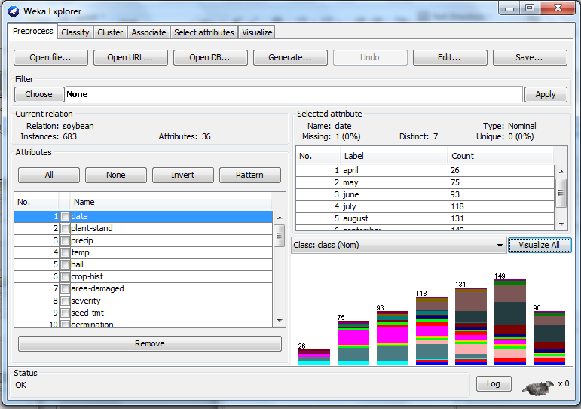
load
filter
analyze

Slide 13
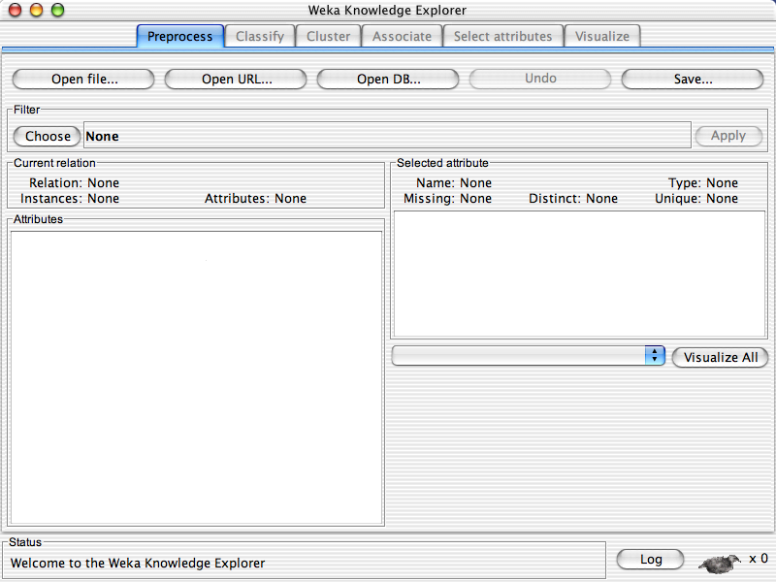

Slide 14
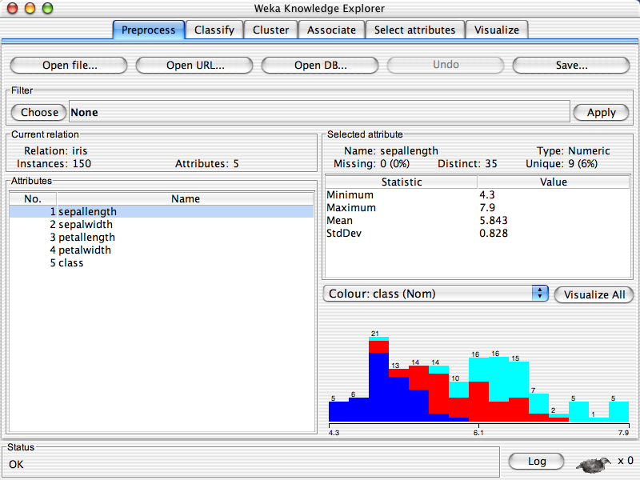

Slide 16
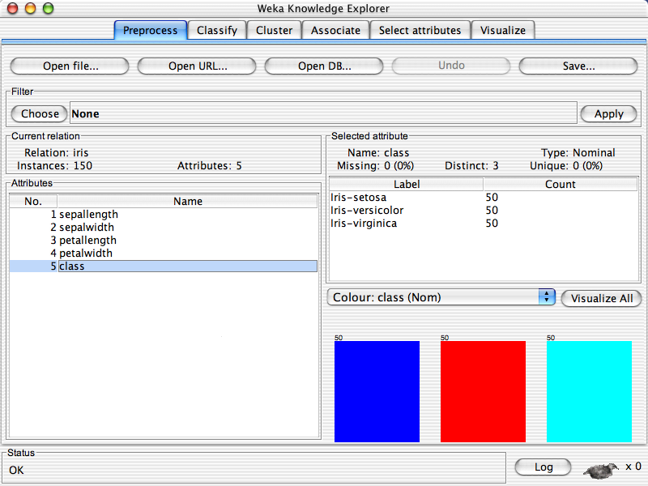

Slide 18
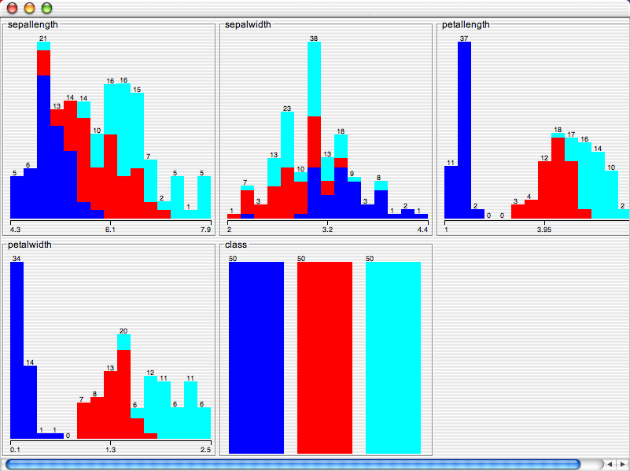

Slide 19
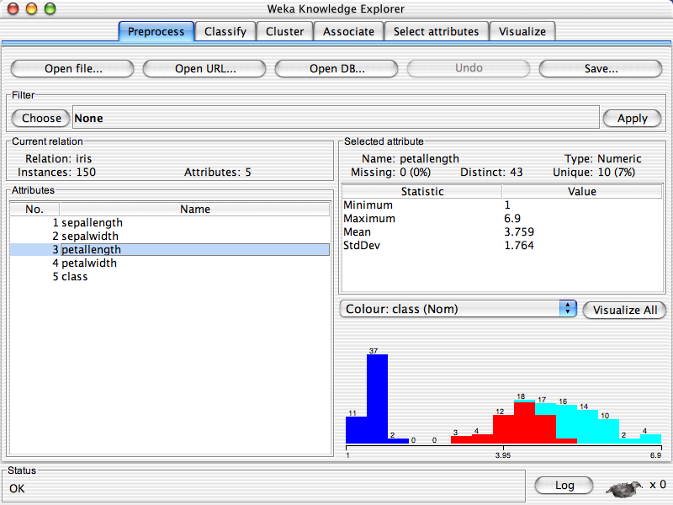

Slide 20
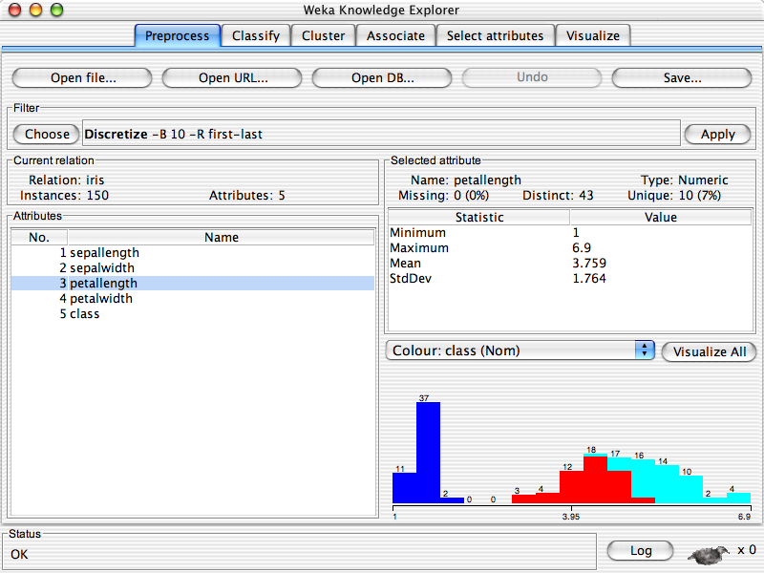

Slide 21
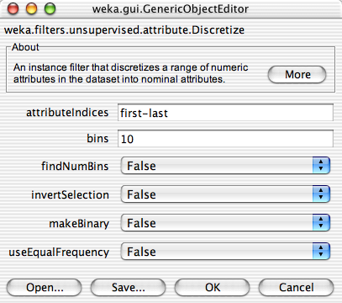

Slide 22
Explorer: building “classifiers”
Classifiers in WEKA are models for predicting nominal or numeric quantities
Implemented learning schemes include:
  Decision trees and lists, instance-based classifiers, support vector machines, multi-layer perceptrons, logistic regression, Bayes’ nets, …

Slide 24
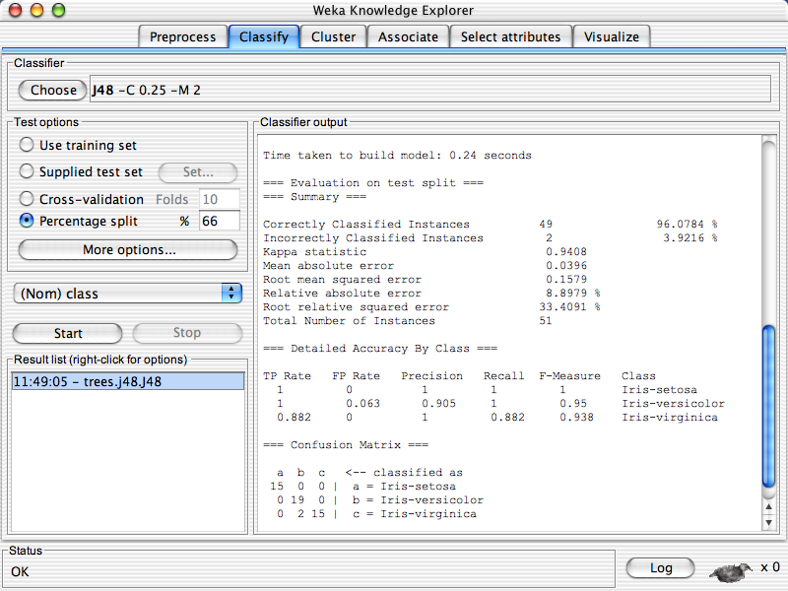

Slide 25
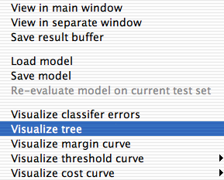

Slide 26
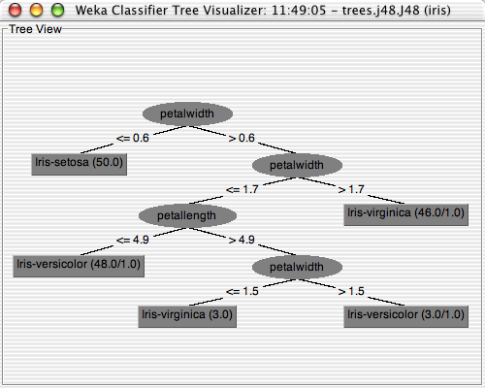

Slide 27
Explorer: clustering data
WEKA contains “clusteres” for finding groups of similar instances in a dataset
Implemented schemes are:
  k-Means, EM, Cobweb, X-means, FarthestFirst,…
Given k, the k-means algorithm is implemented in four steps:
  Partition objects into k nonempty subsets
  Compute seed points as the centroids of the clusters of the current partition (the centroid is the center, i.e., mean point, of the cluster)
  Assign each object to the cluster with the nearest seed point
  Go back to Step 2, stop when no more new assignment

Slide 28
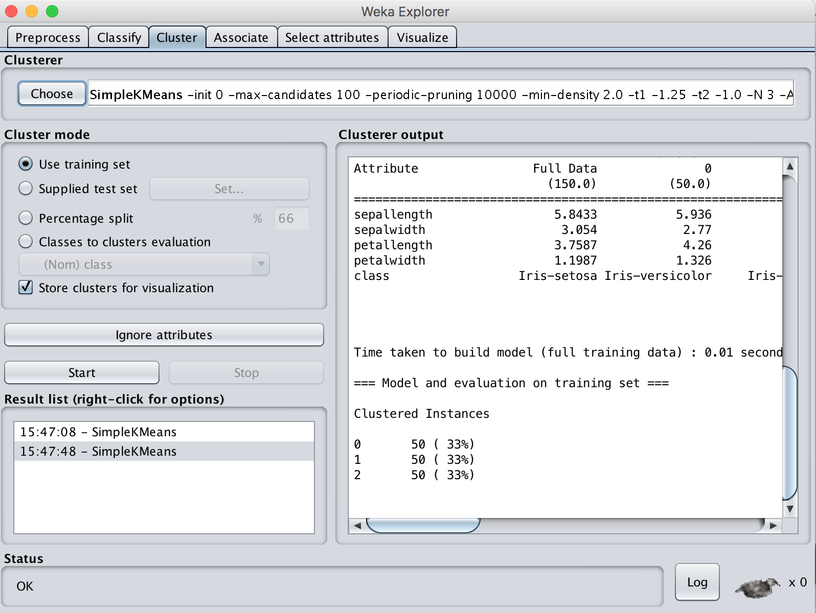
1
2
3

Slide 29
Explorer: attribute selection
Panel that can be used to investigate which (subsets of) attributes are the most predictive ones
Attribute selection methods contain two parts:
  A search method: best-first, forward selection, random, exhaustive, genetic algorithm, ranking
  An evaluation method: correlation-based, wrapper, information gain, chi-squared, …
Very flexible: WEKA allows (almost) arbitrary combinations of these two

Slide 30
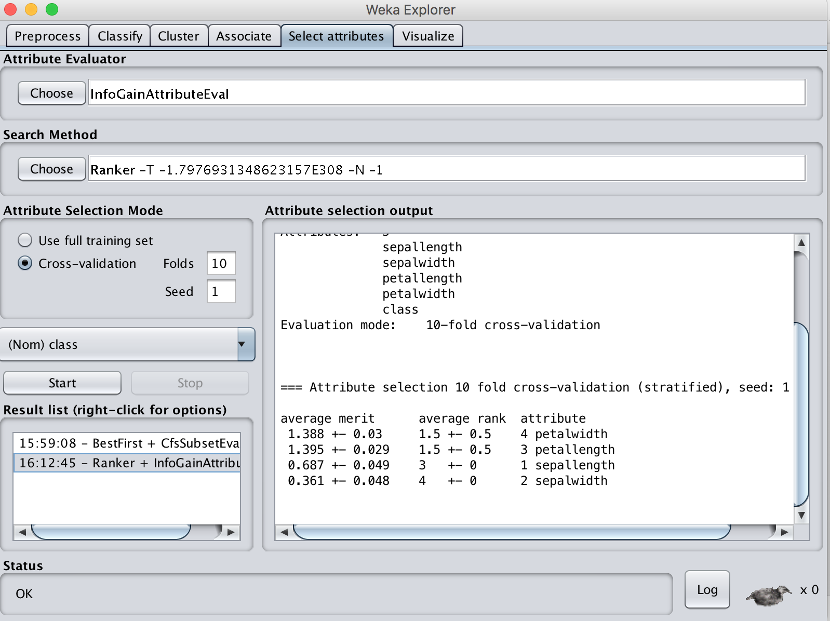

Slide 31
Explorer: data visualization
Visualization is very useful in practice: e.g. helps to determine difficulty of the learning problem
WEKA can visualize single attributes (1-d) and pairs of attributes (2-d)
  To do: rotating 3-d visualizations (Xgobi-style)
Color-coded class values
“Jitter” option to deal with nominal attributes (and to detect “hidden” data points)
“Zoom-in” function

Slide 32
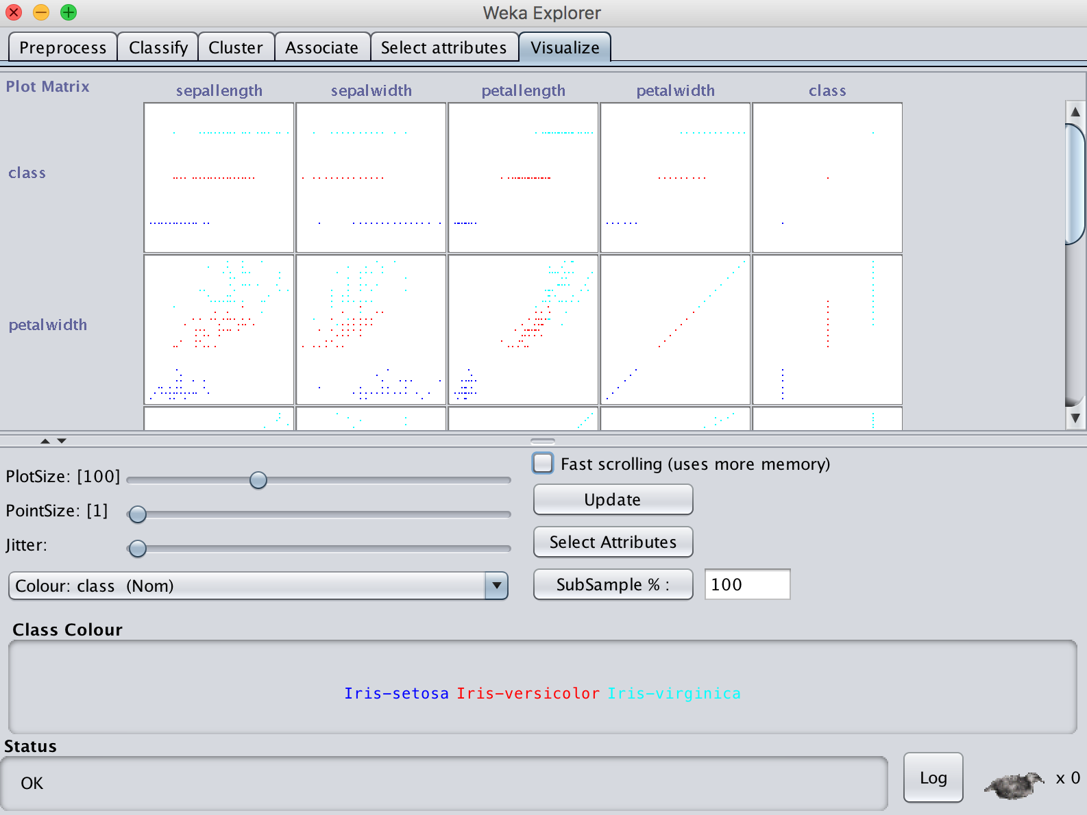

Slide 33
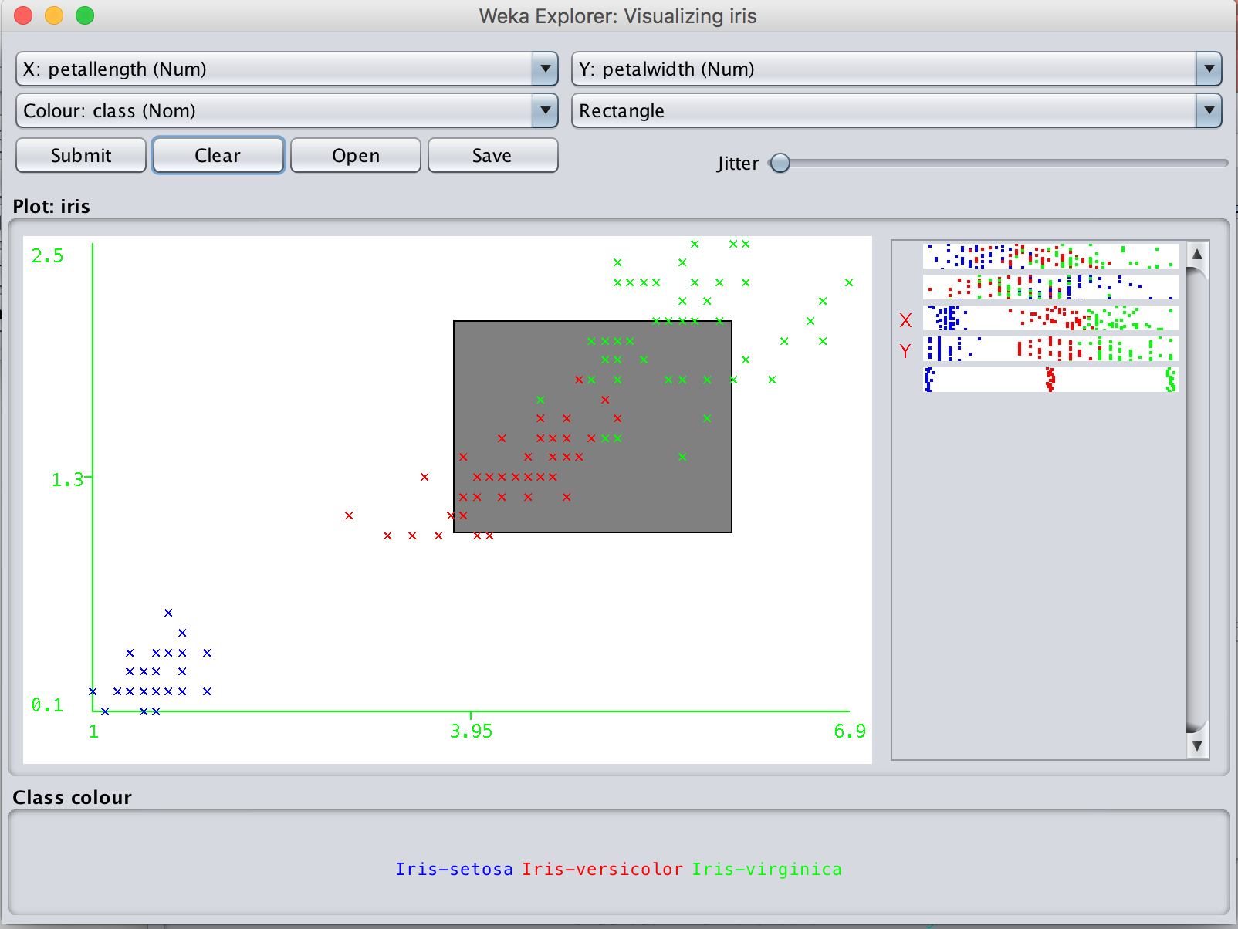
1
3
2

Slide 34
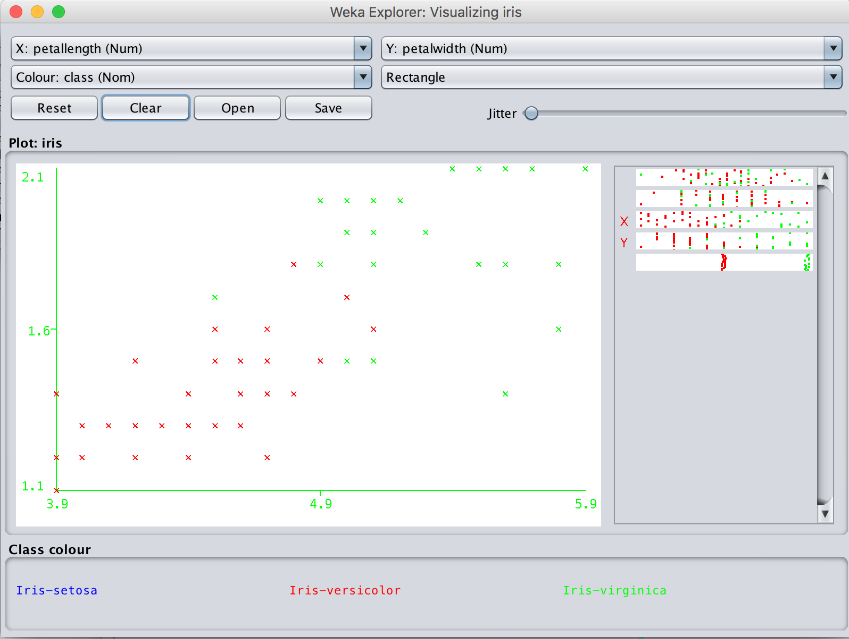

Slide 35
References and Resources
References:
  WEKA website: http://www.cs.waikato.ac.nz/~ml/weka/index.html
  WEKA Tutorial:
    Machine Learning with WEKA: A presentation demonstrating all graphical user interfaces (GUI) in Weka.
    A presentation which explains how to use Weka for exploratory data mining.
  WEKA Data Mining Book:
    Ian H. Witten and Eibe Frank, Data Mining: Practical Machine Learning Tools and Techniques (Second Edition)
  WEKA Wiki: http://weka.sourceforge.net/wiki/index.php/Main_Page
  Others:
    Jiawei Han and Micheline Kamber, Data Mining: Concepts and Techniques, 2nd ed.

